Slide 1



Module 2. Lesson 1.
Classes. Introduction to PyQt
Link to guidelines

Slide 2

Module 2. Lesson 1. Classes. Introduction to PyQt
Discussion:
Creating applications

Slide 3
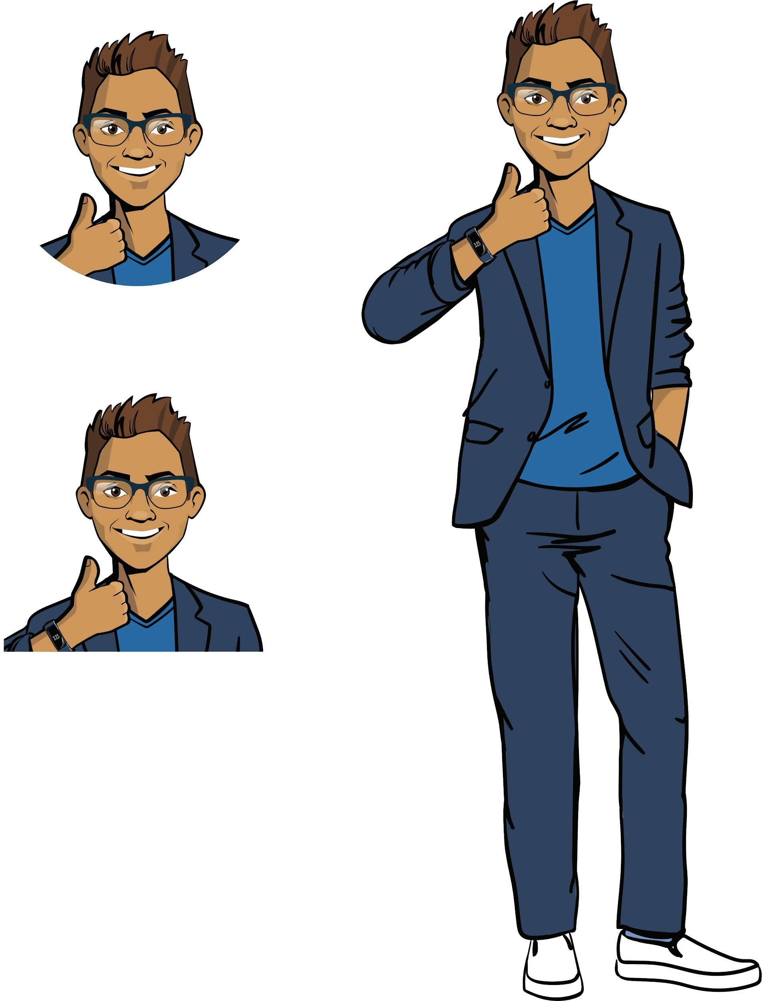

Yay, a new request!
The creators of the Crazy People YouTube channel want to hold a prize drawing for their subscribers. They need an application that outputs a random number when a button is pressed.
This application will be made publicly available so that each participant can see how it works.
Ready to get started?
Discussing
work tasks
Cole,
senior developer

Slide 4
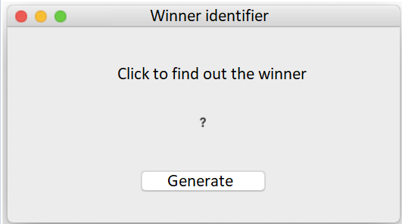
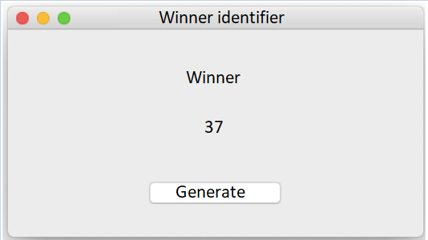

Let’s look at the task
Product type: application (for a computer).
Functionality: display a random number when clicked.
Discussing
work tasks
The program window immediately after launching it.
Generating a random number
from 1 to 100 by pressing the button.

Slide 5
Let’s look at the task
Product type: application (for a computer).
Functionality: display a random number when clicked.
Discussing
work tasks
What tools do we need to complete such a request?

Slide 6
Let’s look at the task
The "Winner Identifier" application
Application functionality
Application interface
Generating random numbers (the random module).
Creating a graphical user interface.
Processing mouse events with interface elements.
Discussing
work tasks

Slide 7
Let’s look at the task
The "Winner Identifier" application
Application functionality
Application interface
Generating random numbers (the random module).
Creating a graphical user interface.
Processing mouse events with interface elements.
Discussing
work tasks
You can create an application for a computer with a graphical interface using the professional PyQt library.

Slide 8
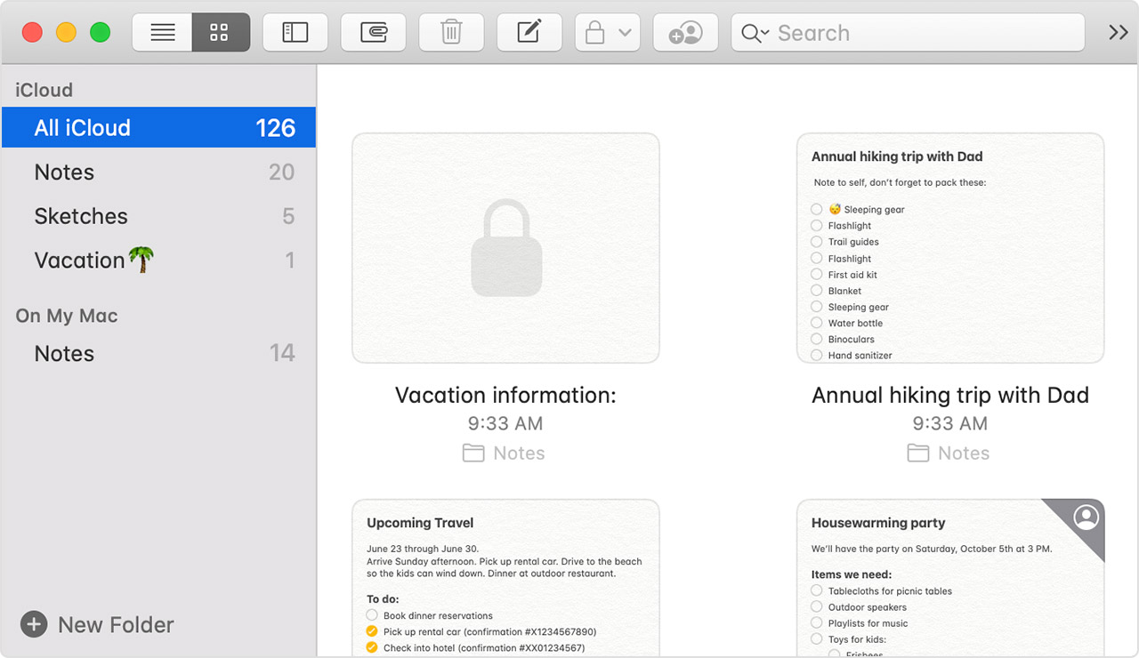
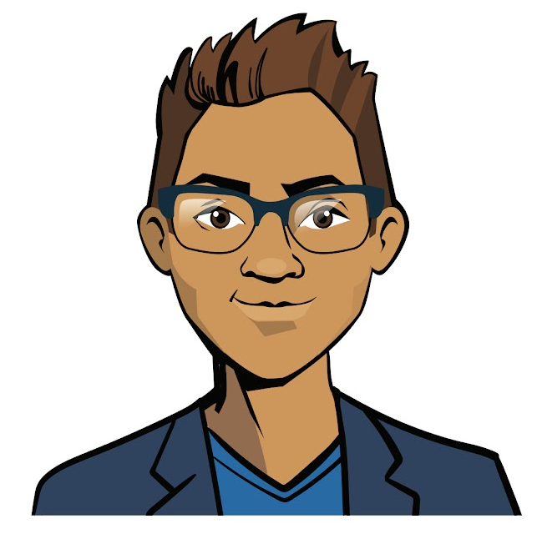
Creating applications
Each element of the application interface is endowed with certain properties that you need to be able to work with.
It is difficult, but very interesting!
Discussing
work tasks

Slide 9
The goal of the work day is
Learn the basic PyQt library tools and create an application displaying the winner’s number.
Today you will:
Discussing
work tasks
recall what an object, property, and method are, and what types of objects there are in applications;
learn what an interface and windowed application are, and how to program them using PyQt;
create your first application for a PC!

Slide 10

Module 2. Lesson 1. Classes. Introduction to PyQt
Brainstorming:
Object-oriented programming

Slide 11
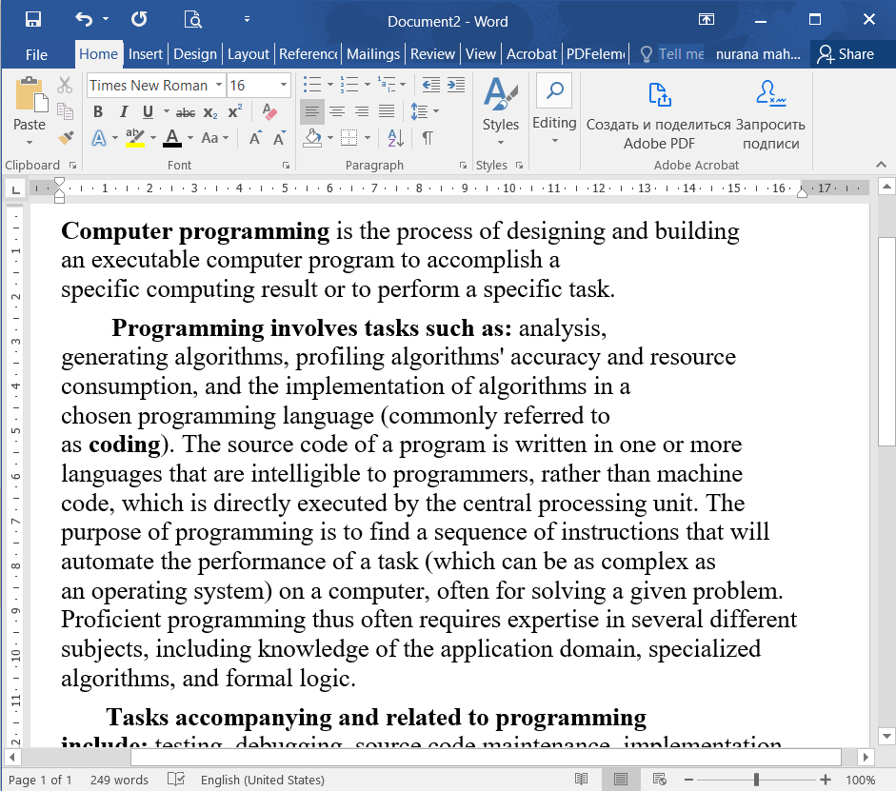
Creating applications
The interface of a windowed application consists of many objects (buttons, labels, etc.)
The PyQt library describes many types of such objects.
Each type has its own properties and methods.
Brainstorming

Slide 12
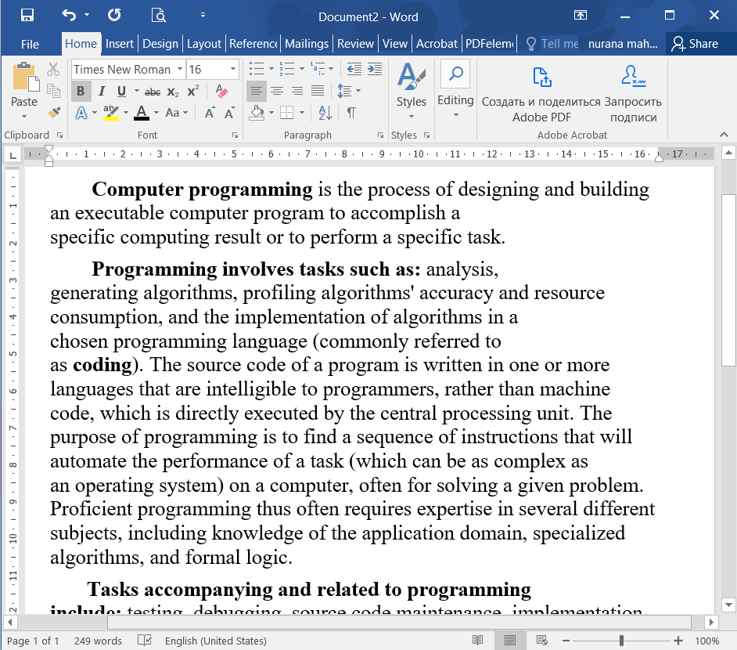
Creating applications
To use PyQt tools properly, you need to
know the main types of interface objects (classes);
be able to create the object you need (class instance);
be able to work with the properties and methods of interface objects (class fields and methods).
Brainstorming

Slide 13
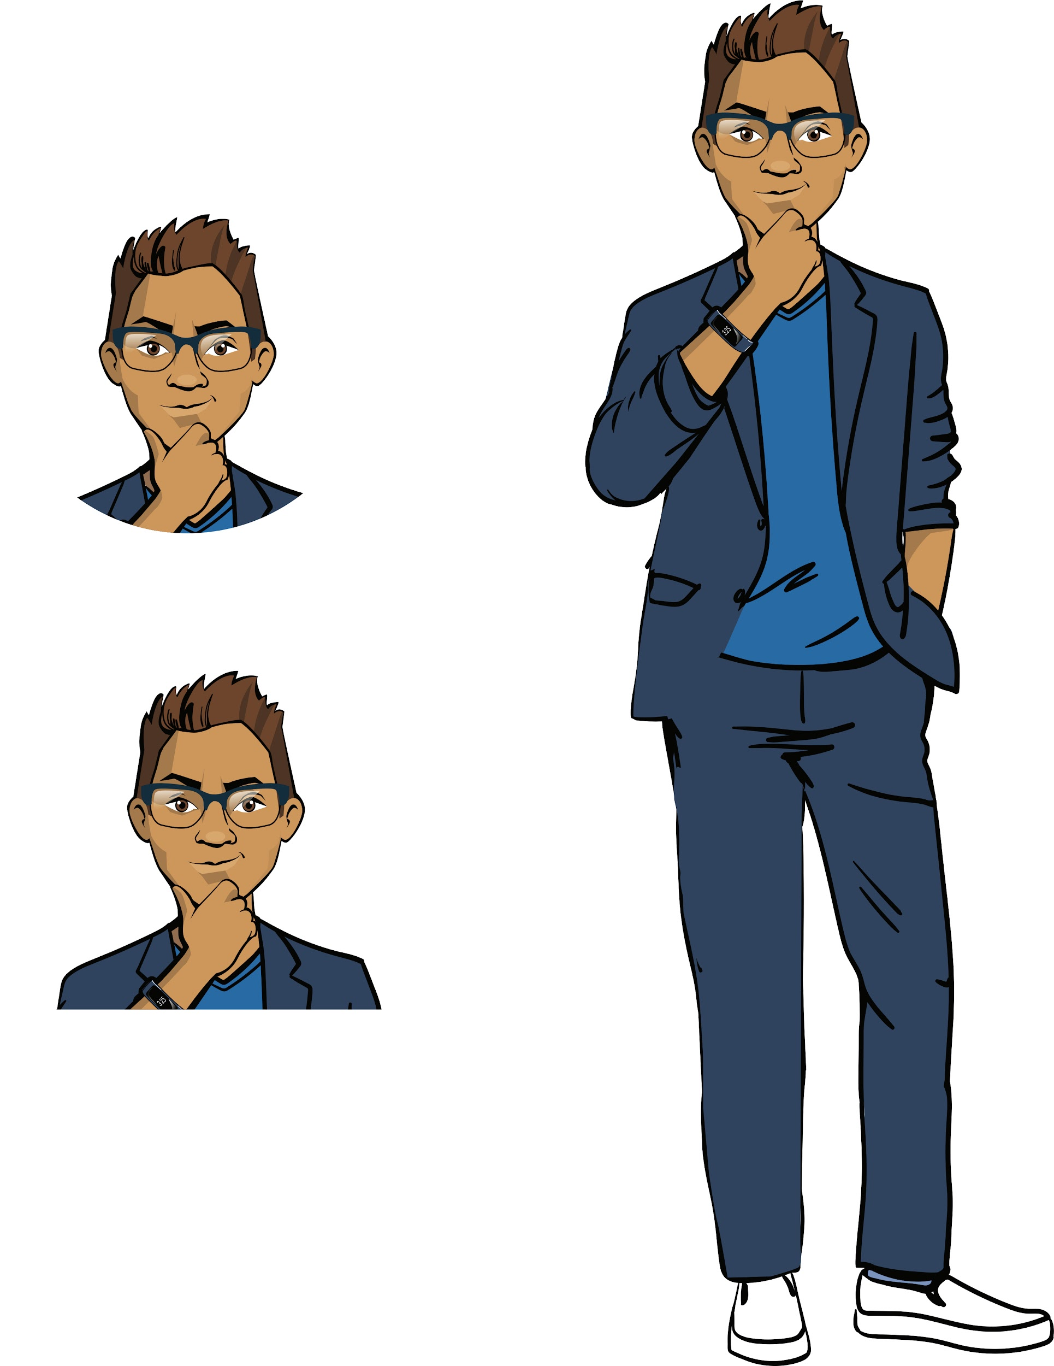
Object-oriented programming
When we were working with the Turtle module, you learned about the concepts of "object," "object property," and "object method."
The approach to creating programs in which a program is considered a collection of objects of different types is called object-oriented.
Brainstorming
This approach is great for creating applications!

Slide 14
What is an object?
Which examples of objects do you know?
Brainstorming

Slide 15
An object
is a collection of data and actions that represent a whole.
Object 1
Object 2
Object 3
DATA
DATA
DATA
Brainstorming
ACTIONS
ACTIONS
ACTIONS
Object types can be quite different.
When programming in the object-oriented approach, you can come up with your own object types.

Slide 16
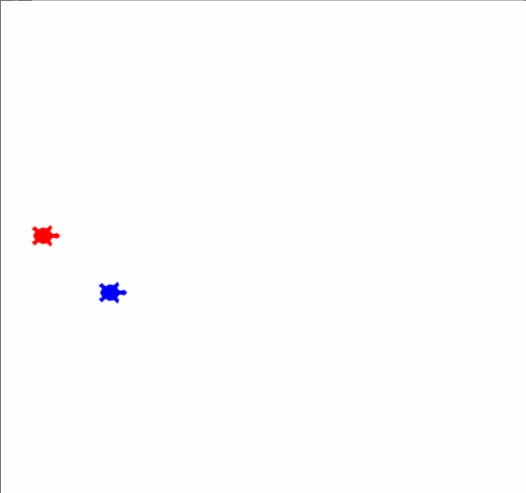
An object
is a collection of data and actions that represent a whole.
Example (objects of the "turtle" type):
t1 = Turtle()
t2 = Turtle()
Brainstorming
Each turtle is endowed with data (color, shape) and actions (moving to a point, in a straight line, etc.).

Slide 17
What is a property?
What is a method?
Brainstorming

Slide 18
A property
is a variable inside an object.
A method
is a function inside an object.
Task.
You are given a piece of code. What are the names of the mutable objects and their types? List the properties and methods provided in the program.
t1 = Turtle()
t2 = Turtle()
t1.color('red')
t1.shape('turtle')
t1.penup()
t1.goto(-1 * width, 30)
t2.color('blue')
t2.shape('turtle')
Brainstorming

Slide 19
A property
is a variable inside an object.
A method
is a function inside an object.
Task.
You are given a piece of code. What are the names of the mutable objects and their types? List the properties and methods provided in the program.
t1 = Turtle()
t2 = Turtle()
t1.color('red')
t1.shape('turtle')
t1.penup()
t1.goto(-1 * width, 30)
t2.color('blue')
t2.shape('turtle')
Brainstorming
Creating two Turtle objects t1 and t2.
Changing the "color" and "shape" properties of the t1 object.
Applying the "pen up" and "goto" methods to the t1 object.
Changing the "color" and "shape" properties of the t2 object.

Slide 20

t1 = Turtle()
t2 = Turtle()
By naming the object type, we show which class it belongs to.
it’s a turtle
Object
Object class
Brainstorming
Our knowledge about all these objects

Slide 21
Class
a single name for many objects;
in programming: a general description of how these objects should be arranged.
Classes
Brainstorming
Ready-made
Your own
Already described in libraries
The properties and methods need to be described

Slide 22
Class
a single name for many objects;
in programming: a general description of how these objects should be arranged.
Classes
Brainstorming
Let's explore how classes work by creating some of our own classes.
Ready-made
Your own
Already described in libraries
The properties and methods need to be described

Slide 23
Creating classes
To create a class, we need to do the following:
list the properties that define the characteristics of an instance of the class;
list the methods for managing an instance.
Brainstorming

Slide 24
Creating classes
To create a class, we need to do the following:
list the properties that define the characteristics of an instance of the class;
list the methods for managing an instance.
class Application():
def __init__(self, title_text):
self.title = title_text
def print_info (self):
Class name
Value
Brainstorming
Property name
Value
Method name
Action with object and properties
Action with object and properties

Slide 25
Creating classes
To create a class, we need to do the following:
list the properties that define the characteristics of an instance of the class;
list the methods for managing an instance.
class Application():
def __init__(self, title_text):
self.title = title_text
def print_info (self):
Class name
A special constructor function that creates an instance of a class with the specified properties.
Value
Brainstorming
Property name
Value
Method name
Action with object and properties
__init__
Action with object and properties
Two underscores.

Slide 26
Creating classes
To create a class, we need to do the following:
list the properties that define the characteristics of an instance of the class;
list the methods for managing an instance.
class Application():
def __init__(self, title_text):
self.title = title_text
def print_info (self):
Class name
self is a parameter indicating the object to which the method is applied.
self.property is a property of the object to which the method is applied.
Value
Brainstorming
Property name
Value
Method name
Action with object and properties
Action with object and properties

Slide 27
Creating classes
Example (for console). Application class
class Application():
def __init__(self, title_text, description_text, volume_num):
self.title = title_text
self.description = description_text
self.volume = volume_num
def print_info(self):
print('Application', self.title)
print('Description:', self.description)
print('Application size:', self.volume)
Brainstorming
Name the properties (fields) of the class.
Show the class constructor.
Name the class methods and describe how they work.

Slide 28
Creating classes
Example (for console). Application class
class Application():
def __init__(self, title_text, description_text, volume_num):
self.title = title_text
self.description = description_text
self.volume = volume_num
def print_info(self):
print('Application', self.title)
print('Description:', self.description)
print('Application size:', self.volume)
my_app = Application('Winner Identifier', 'Display a random participant’s number', 50)
my_app.print_info()
Brainstorming
Creating an instance with specific properties.

Slide 29
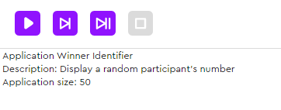
Creating classes
Example (for console). Application class
class Application():
def __init__(self, title_text, description_text, volume_num):
self.title = title_text
self.description = description_text
self.volume = volume_num
def print_info(self):
print('Application', self.title)
print('Description:', self.description)
print('Application size:', self.volume)
my_app = Application('Winner Identifier', 'Display a random participant’s number', 50)
my_app.print_info()
Brainstorming

Slide 30
Before continuing:
What will the previous program display if we put the following data in the constructor:
'Game "Programmer simulator"'
'Work your way from beginner to company director!'
100
Can we create another instance of the Application class in the previous program?
If you were creating a Programmer class, what properties would you define in the constructor? And what methods?
Brainstorming

Slide 31
Conclusions:
A class is the name of a collection of objects and a description of how they are arranged.
The following is described in a class:
class constructor (the __init__() method),
properties (in the constructor),
methods.
self is a parameter indicating the object to which the method is applied.
Brainstorming

Slide 32
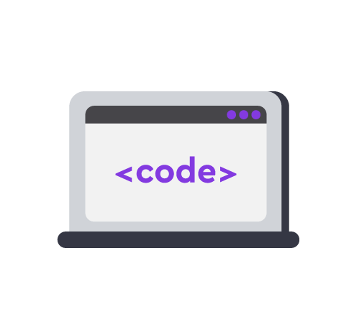
Module 2. Lesson 1. Classes. Introduction to PyQt
Visual Studio Code:
Preparing to create applications

Slide 33
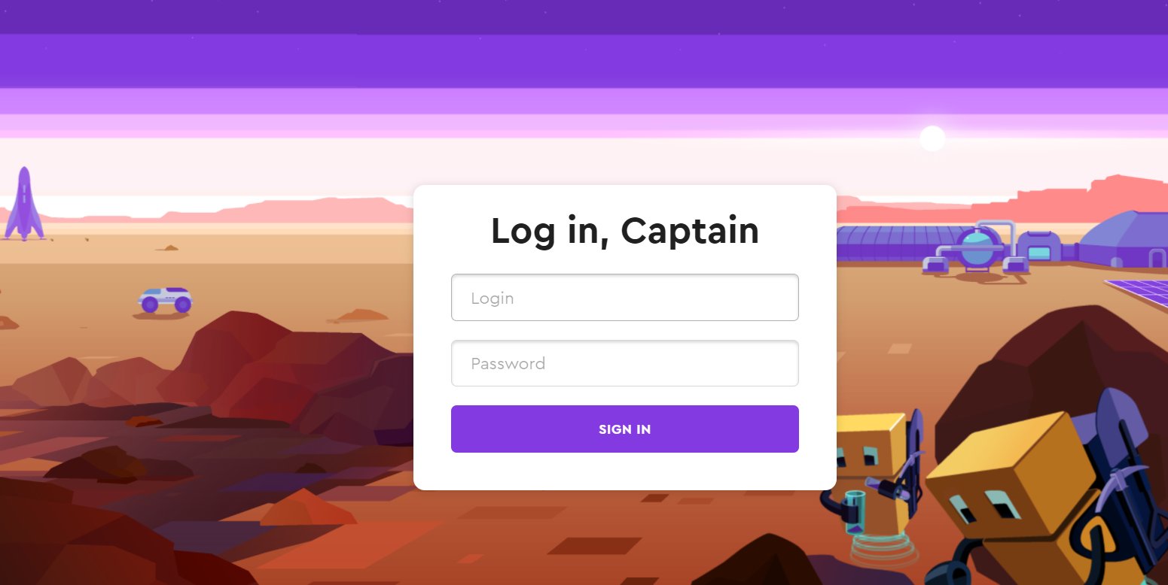
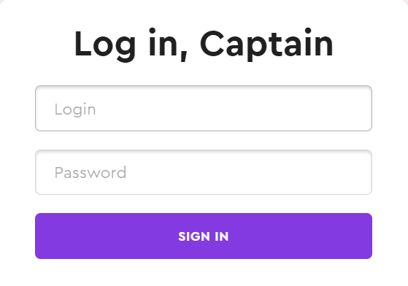
Professional development environment
Starting today, we are going to write programs using a professional tool—Visual Studio Code.
The platform is conveniently integrated into it.
Open Algopython and enter your username and password.
Preparing to create applications

Slide 34
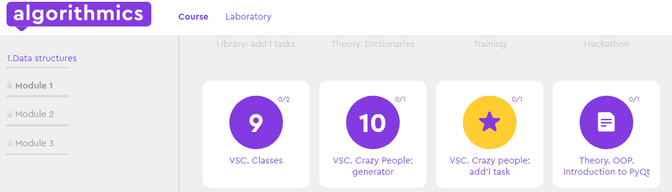
Professional development environment
We will use Algopython for development only.
Only open tasks in it marked VSC.
Preparing to create applications

Slide 35
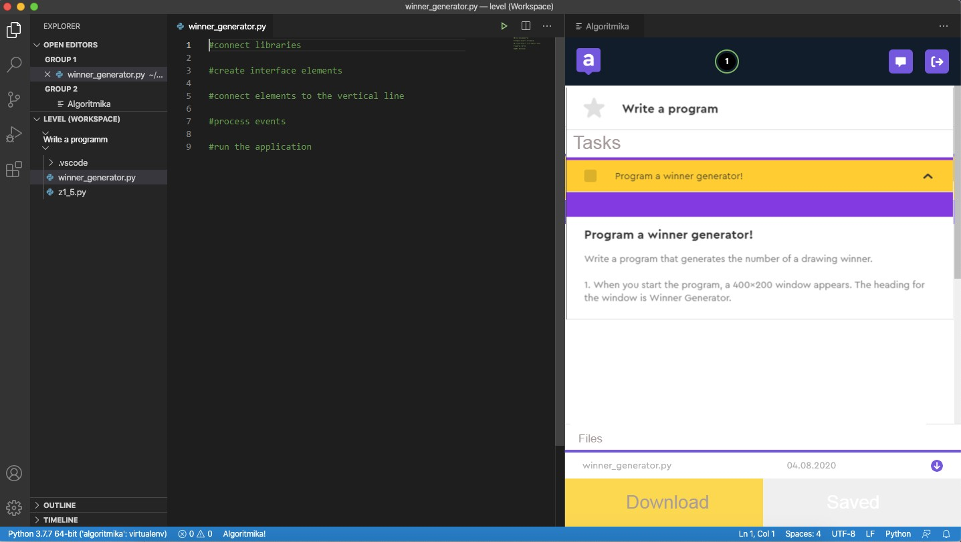
Professional development environment
On the left is the development space;
on the right is the
task manager and tips.
Preparing to create applications
Explorer
Development space
Tasks

Slide 36
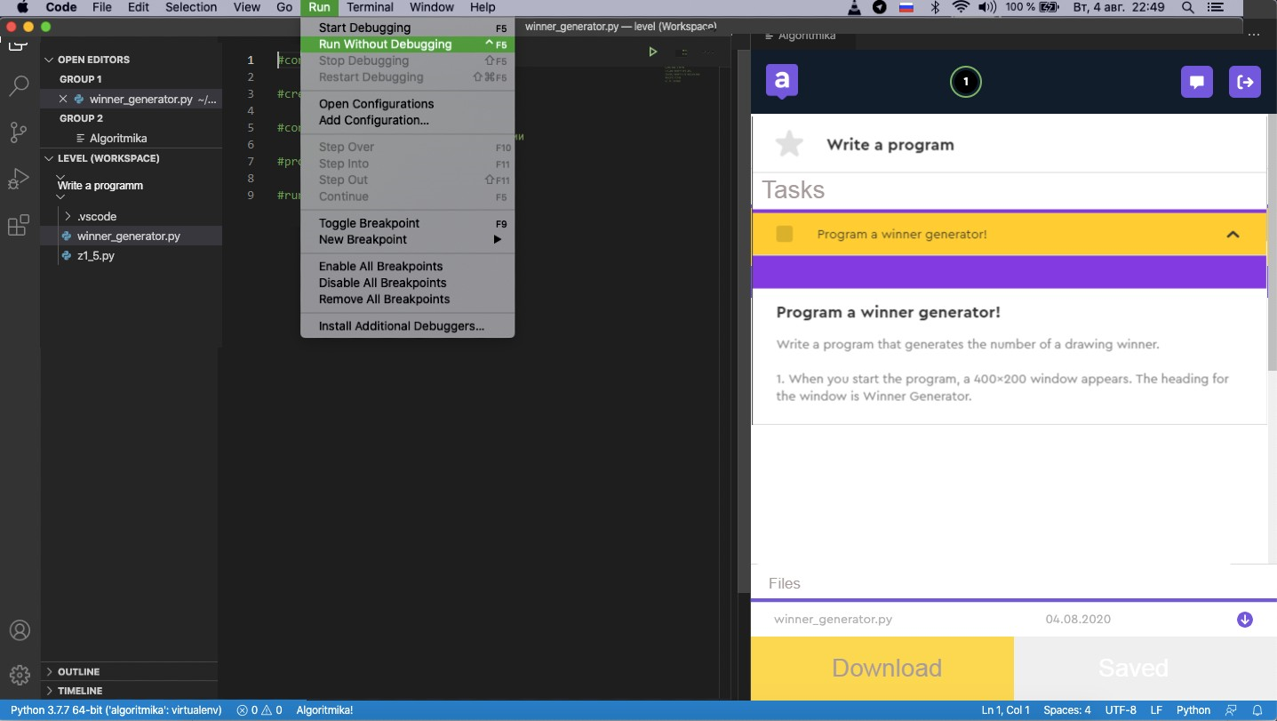
Professional development environment
To run the program:
Run ->
Run without...
Preparing to create applications
Explorer
Development space
Tasks

Slide 37


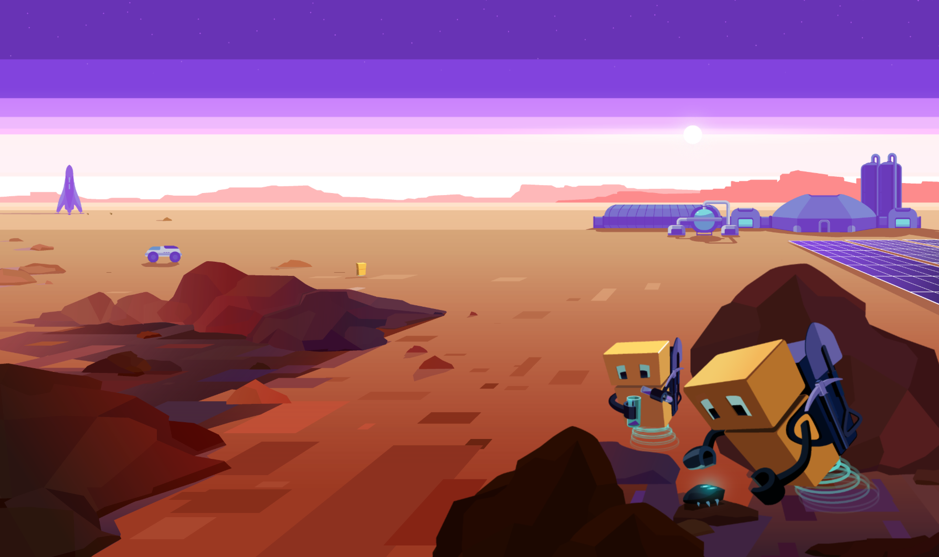
Complete the task in VS Code
VSC. Classes
Visual Studio Code from Algorithmics
Preparing to create applications

Slide 38
Module 2. Lesson 1. Classes. Introduction to PyQt
Brainstorming:
Introduction to PyQt5

Slide 39
Let’s look at the customer's task
To complete the request, we need to do the following:
create a graphical interface for the program,
process button clicking.
Brainstorming
The program window immediately after running it.
Generating a random number
from 1 to 100 by pressing the button.

Slide 40
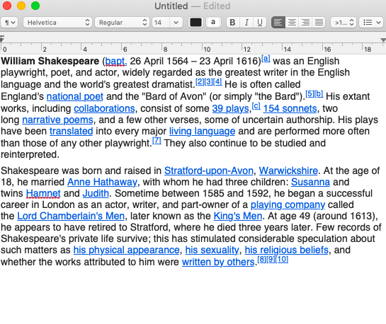
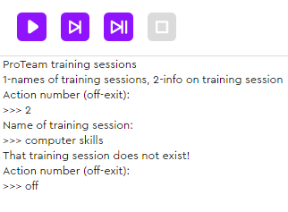
A windowed application
is a computer program that interacts with the user through a graphical interface.
Brainstorming
This is a windowed application.
This is not a windowed application.

Slide 41
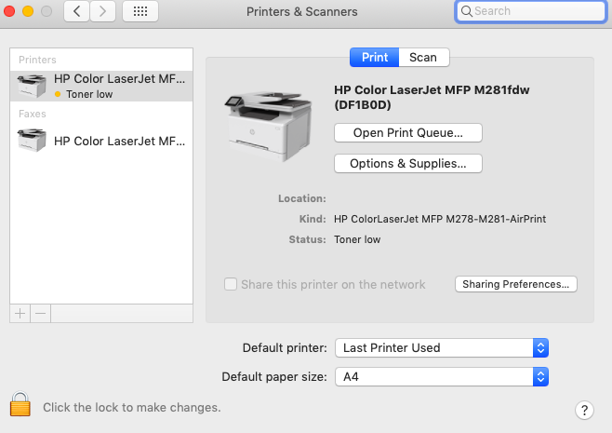
Windowed applications
A standard windowed application consists of the following:
a main window,
controls (widgets),
additional windows (optional).
Main window
Brainstorming
Application interface
Widgets

Slide 42
Windowed applications
Popular widgets that can be placed in a window:
label,
button,
switch,
flags,
text input fields,
lists.
Text input field
Brainstorming
Button
List
Flag
Drop-down list
Label

Slide 43
Positioning widgets in the window
There are two main ways to position widgets:
by coordinates,
along guide lines.
Using coordinates allows you to place a widget absolutely anywhere, but that is the only easy thing about them...
Brainstorming

Slide 44
Positioning widgets in the window
It turns out that guide lines are much easier to use!
the widgets are automatically aligned horizontally and vertically.
Brainstorming

Slide 45
Windowed application operation
Any windowed application works in 2 phases:
the interface rendering phase (when launching the app);
the event processing phase (while the program is running).
Launching the application
Phase 1: widget rendering
Brainstorming
Exit button not pressed?
No
Yes
Phase 2: outside world event loop processing (Is the button pressed? Is the checkbox checked?)
Remember that games work in a similar way!
Shutting down the application

Slide 46
PyQt5
is a cross-platform library for building windowed applications.
It is a professional tool that many programmers use.
The applications you create can be run on any operating system (in the classroom on Windows, at home on Mac OS).
The library contains lots of modules to implement the most daring ideas.
Brainstorming

Slide 47
The Winner Generator application
Step 1. Create the application interface.
Import the necessary library modules.
Create the application (application object).
Create the main window of the application (widget object).
Create labels and buttons (widget objects).
Position the content along the guide line.
Brainstorming

Slide 48
Importing PyQt modules
The PyQt library has a complex hierarchical structure.
We'll need two modules from the core framework: QtCore and QtWidgets.
QtCore
QtWidgets
. . .
The Qt module:
constants and flags which determine how the window looks
The QApplication, QWidget, QLabel, and QVBoxLayout modules:
widgets and how they are positioned
Brainstorming

Slide 49
Importing PyQt modules
from PyQt5.QtCore import Qt
from PyQt5.QtWidgets import QApplication, QWidget, QPushButton, QLabel, QVBoxLayout
Object | Designation
Application | QApplication
Application window | QWidget
Label | QLabel
Button | QPushButton
Vertical guide line | QVBoxLayout
Brainstorming

Slide 50
Creating an application and main window
Application:
Method | Purpose
app = QApplication([]) | Constructor that creates an Application type object.
app.exec_() | Leave the application open until the exit button is pressed.
Main application window:
Brainstorming
Method | Purpose
main_win = QWidget() | Constructor that creates an Window type object.
my_win.show() | Make the window visible (the window is hidden by default).

Slide 51
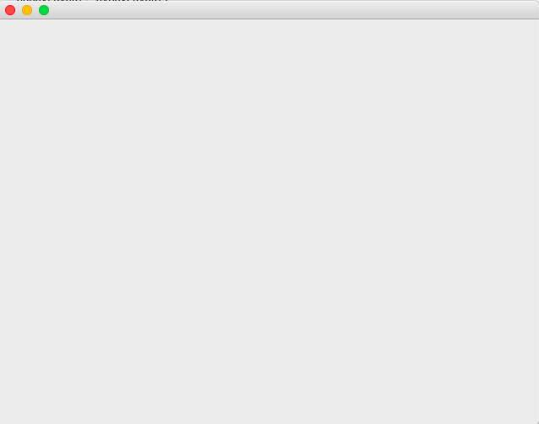
Creating an application and main window
from PyQt5.QtCore import Qt
from PyQt5.QtWidgets import QApplication, QWidget, QPushButton, QLabel, QVBoxLayout
app = QApplication([])
my_win = QWidget()
my_win.show()
app.exec_()
Brainstorming
Using these methods will create an application with one empty window.

Slide 52
Setting up the main window
Method | Purpose
my_win.setWindowTitle(‘Title’) | Set the window title
my_win.move(900, 70) | The window appears at a specified point (not in the center of the screen)
my_win.resize(400, 200) | Resize the window
my_win.show() | Make the window visible
my_win.hide() | Hide the window
Brainstorming
These are just some of the methods; we'll talk about the rest later.

Slide 53
Creating labels and buttons
Label:
Method | Purpose
winner = QLabel('Winner:') | Constructor that creates a Label type object with a specified text
winner.setText('34') | Method that changes the text of the label
Brainstorming
Button:
Method | Purpose
button = QPushButton('Generate') | Constructor that creates a Button type object with a note

Slide 54
Positioning widgets along a line
Line:
Method | Purpose
v_line = QVBoxLayout() | Constructor that creates a Vertical line type object
v_line.addWidget( title, alignment = Qt.AlignCenter ) | Method that adds a widget to a line and places it in the center
my_win.setLayout(v_line) | Add the resulting line and its objects to the application window
Brainstorming

Slide 55
from PyQt5.QtCore import Qt
from PyQt5.QtWidgets import QApplication, QWidget, QPushButton, QLabel, QVBoxLayout
app = QApplication([])
main_win = QWidget()
main_win.setWindowTitle('Winner Identifier')
button = QPushButton('Generate')
text = QLabel('Click to find out the winner')
winner = QLabel('?')
line = QVBoxLayout()
line.addWidget(text, alignment = Qt.AlignCenter)
line.addWidget(winner, alignment = Qt.AlignCenter)
line.addWidget(button, alignment = Qt.AlignCenter)
main_win.setLayout(line)
main_win.show()
app.exec_()
Brainstorming
The window can be resized using the method for that.

Slide 56
Button click processing
Step 2. Event processing (button clicking).
Describe actions when clicking on a button in a separate processor function.
Use a command to link the function and the widget.
def show_winner():
Brainstorming
button.clicked.connect(show_fun_title)
THE FUNCTION IS DESCRIBED SEPARATELY
NAME OF THE PROCESSOR FUNCTION WHICH THE BUTTON RESPONDS TO

Slide 57
Button click processing
Determining the winner in the show_winner() function:
If there are a total of 100 participants, a random number from 1 to 100 is generated.
The text label changes from "Click to find out the winner" to "Winner."
The winner label changes from "?" to the winner's number.
Brainstorming

Slide 58
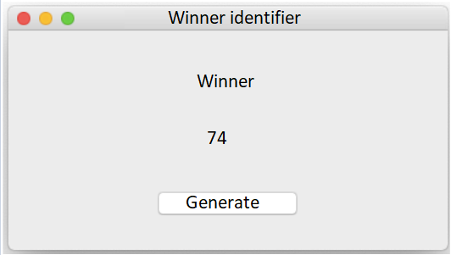
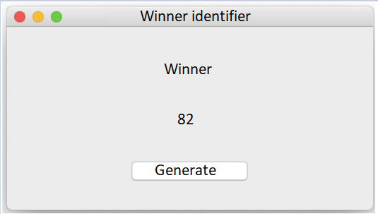
Button click processing
Determining the winner in the show_winner() function:
If there are a total of 100 participants, a random number from 1 to 100 is generated.
The text label changes from "Click to find out the winner" to "Winner."
The winner label changes from "?" to the winner's number.
Brainstorming

Slide 59
Button click processing
from random import randint
#...
def show_winner():
number = randint(0, 99)
winner.setText(str(number))
text.setText('Winner:')
button.clicked.connect(show_winner)
main_win.show()
app.exec_()
Brainstorming

Slide 60
Conclusions:
The PyQt library has a complex hierarchical structure in which many ready-made classes are described.
To import the right module, you need to know its name and position in the structure.
To create a simple application, you need to do the following:
create an application object,
create the main window,
create widgets and arrange them along lines,
process the required events.
Brainstorming

Slide 61
Module 2. Lesson 1. Classes. Introduction to PyQt
Visual Studio Code:
Winner generator

Slide 62
Complete the task in VS Code
VSC. Crazy People:
winner generator
Visual Studio Code from Algorithmics
Creating your first application

Slide 63

Module 2. Lesson 1. Classes. Introduction to PyQt
End of the
work day

Slide 64

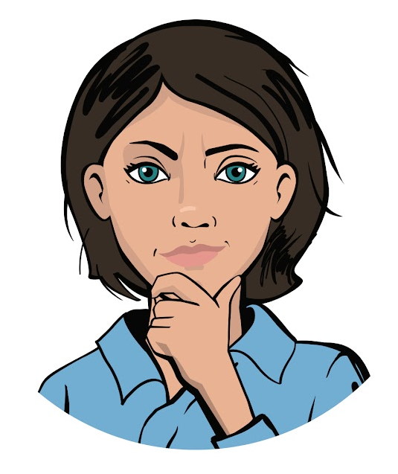
Let’s end the work day by
answering these technical questions:
What is a class? An instance of a class? Class constructor? How do we create a class?
What library is used to create applications? How do we create the most simple application?
What widgets do you know?
Summing up
the work day
Cole,
senior developer
Emily,
project manager

Slide 65
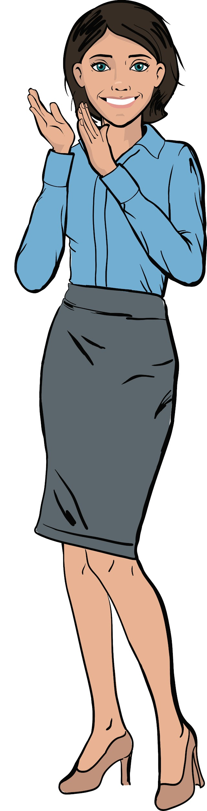
Great job!
Excellent work, colleagues!
Congratulations on the successful delivery of the application to the customer.
Some things were easy, some more difficult, but we managed with it all.
Summing up
the work day

Slide 66
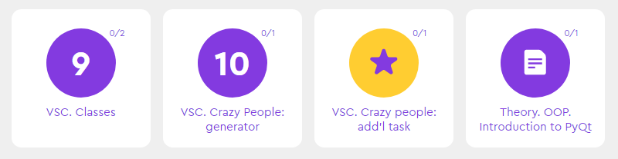
Additional tasks to improve your performance
VSC. Crazy People:
Add’l task
Summing up
the work day

Slide 67
Publishing VS. Code projects
Laboratory

Slide 68
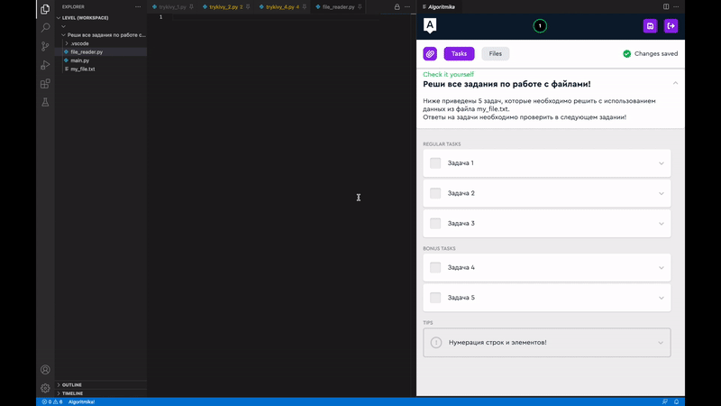

Save the project
1. Click on the icon
2. Enter the name. Use only Latin letters, numbers and the sign "_" The name should not be the same as other project names
Laboratory

Slide 69
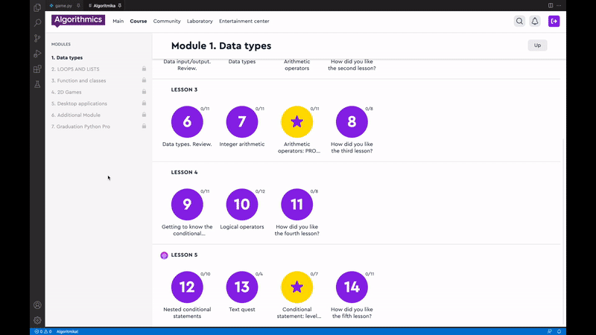
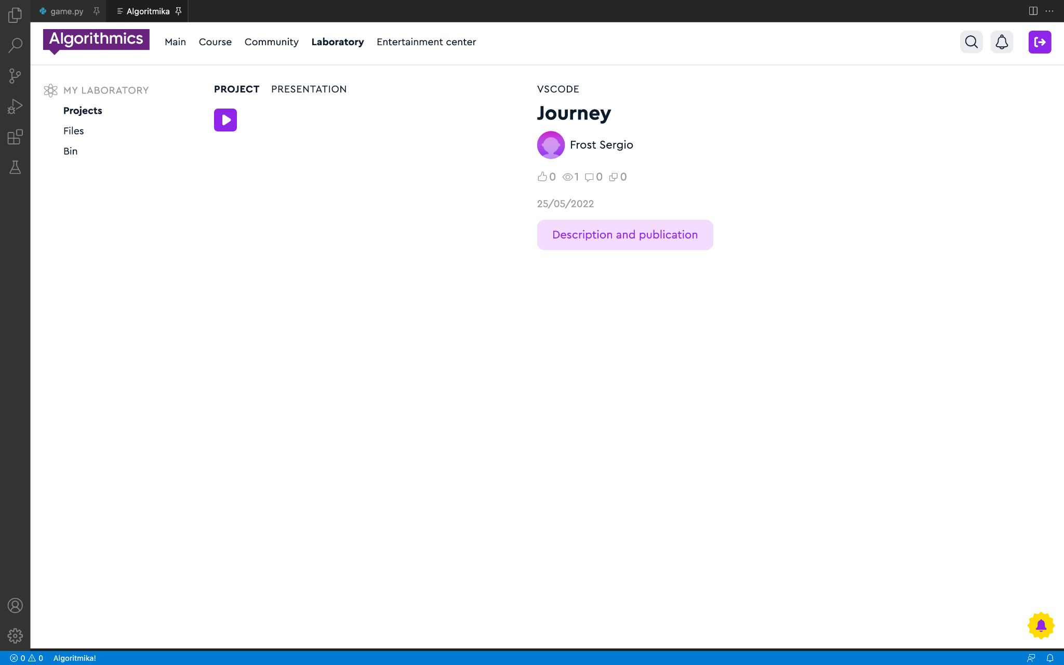
Go to the lab
Click on the project to proceed to editing the description and setting up the publication
Click the "Description and Publication" button
Laboratory

Slide 70
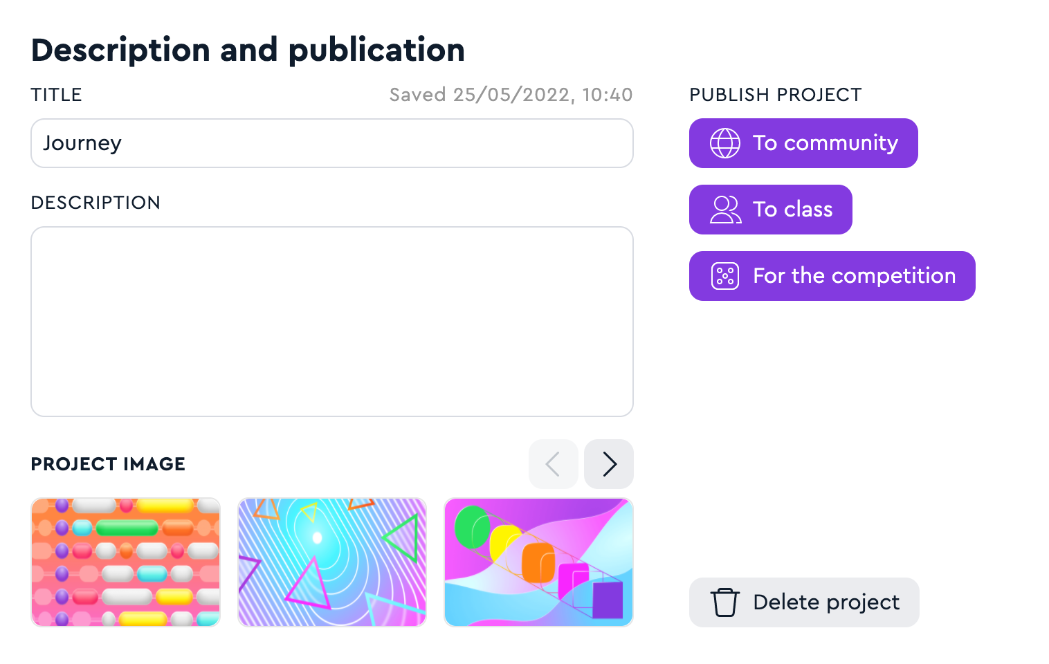
Add a description and publish
2. 1. Enter the name and description
2. 2. Publish your project to the Hall of Fame or Class
Laboratory

